Slide 1

-Adrish Sahu (SRM IST 2019-2023)
-Abhirup Mukherjee(SRM IST 2019-2023)
-Atanu Wadhwa(SRM IST 2019-2023)
-Sreelakshmi K Vijayan(SRM IST 2019-2023)
-Viswadruth Akkaraju (SRM IST 2019-2023)

Slide 2
INDEX OF CONTENTS
OBJECTIVES
2. OVERVIEW OF THE PLANETARY LANDER VIDEO GAME
3. THE STAKES
4. Game Mechanics
5. Fails states and the USP
6. Enhancements

Slide 3
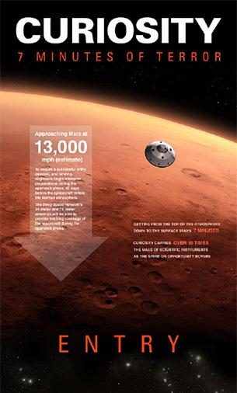
PLANETARY LANDER GAME
An interactive educational game modelled after the seven minutes of Terror during the Martian approach, We aim to make the game as educational as possible by adding in real-life information from different landing missions.
Our primary goal is to have the player follow through all the important stages of approach and descent while simulating just a fraction of the high stakes poker game that takes place during real-world missions.

Slide 4


Slide 5
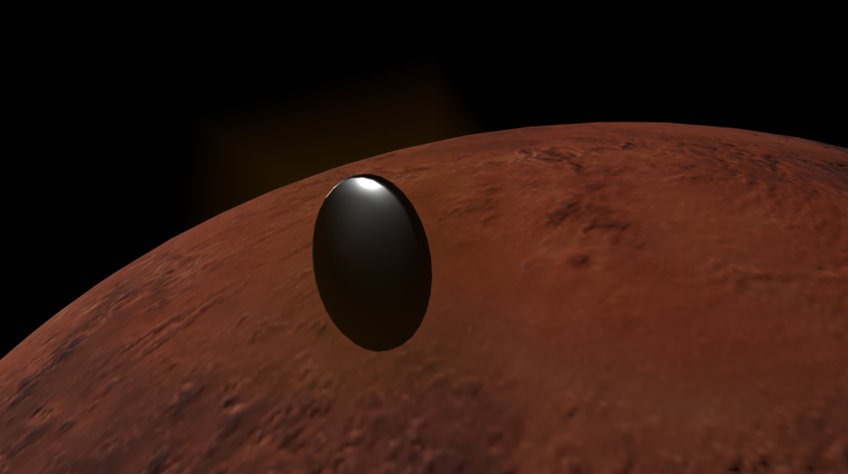

Slide 6
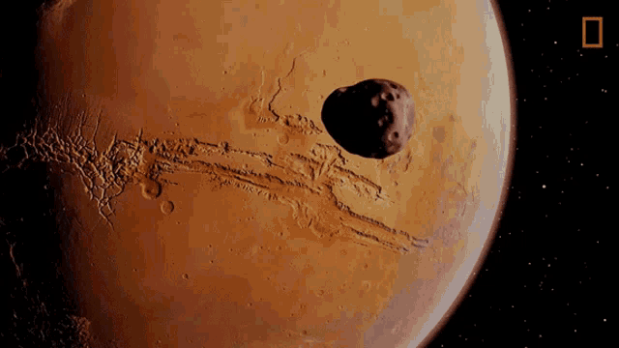
Objective
Survive 10 minutes of Terror

Slide 7
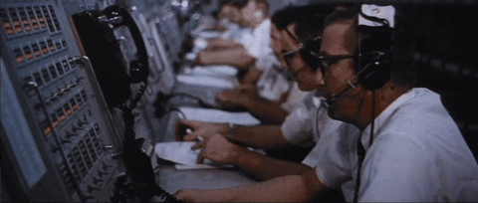
The stakes:
$3 Billion Dollars
1000+ Man hours
The hopes and dreams
Of millions.

Slide 8
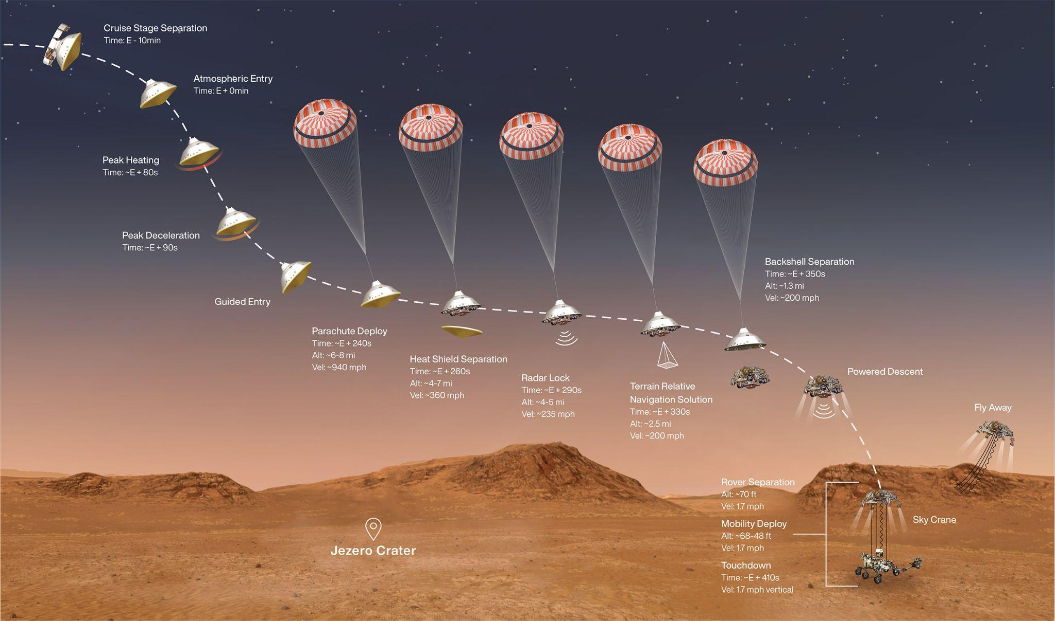
All
Systems
go

Slide 9
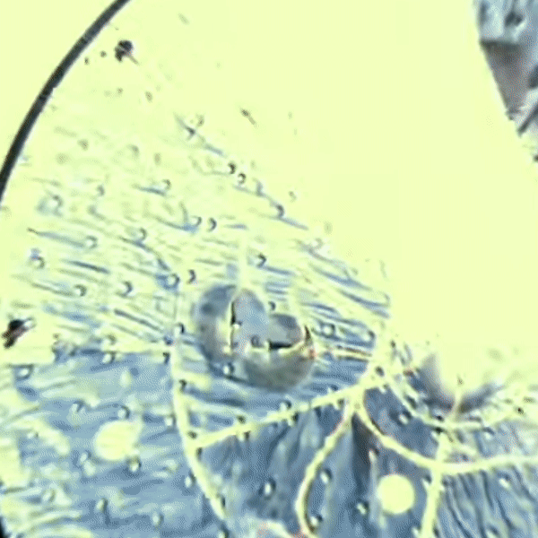

Slide 10
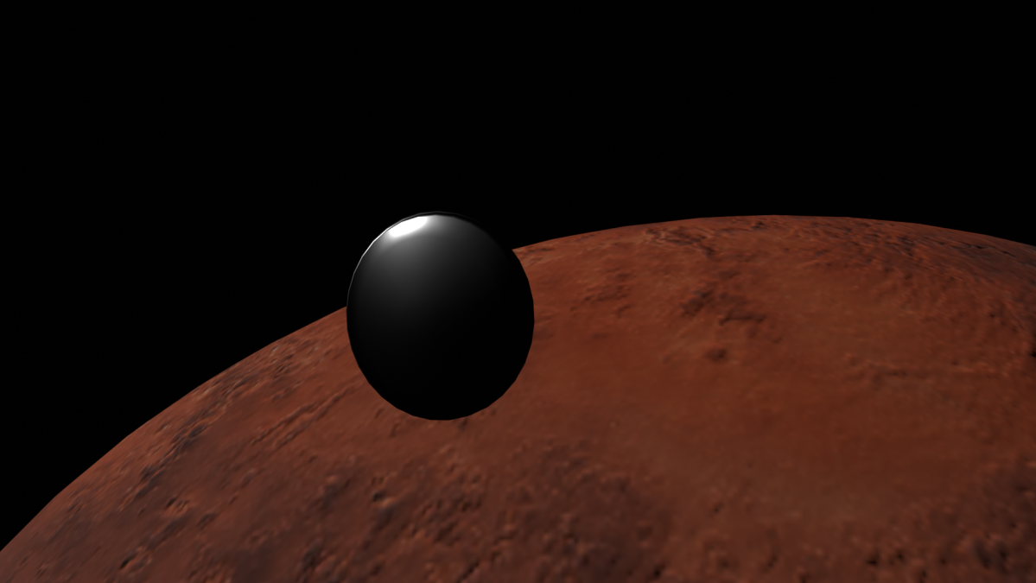

Slide 11
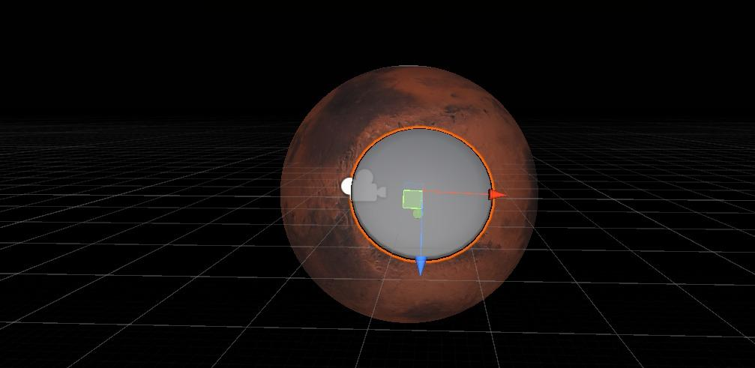

Slide 12


Slide 13
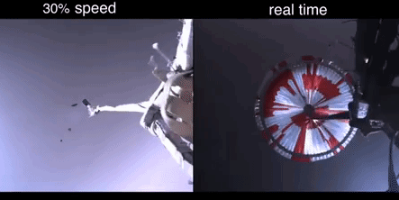

Slide 14
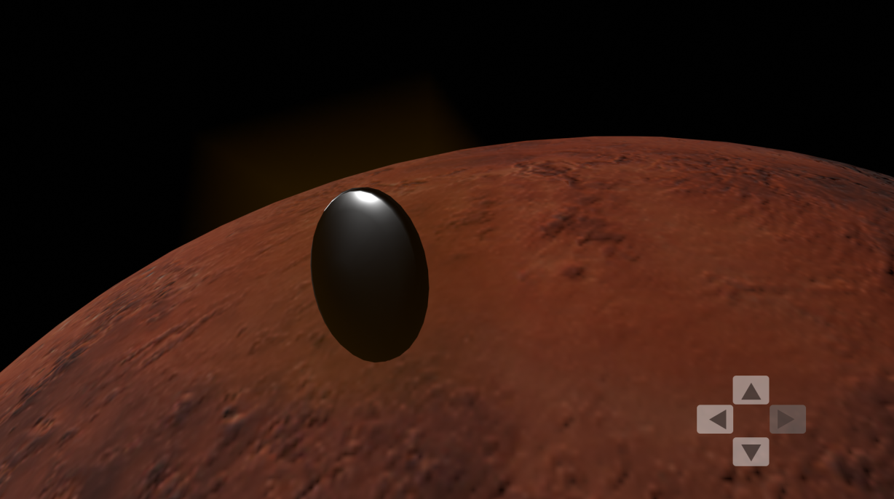

Slide 15
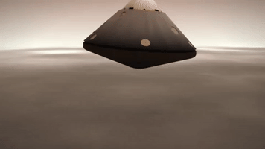

Slide 16
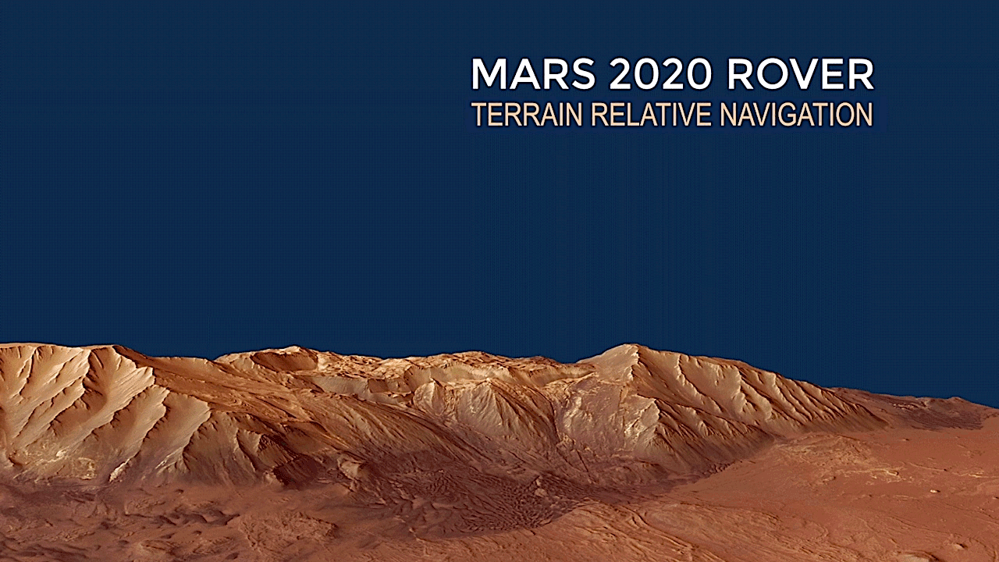

Slide 17
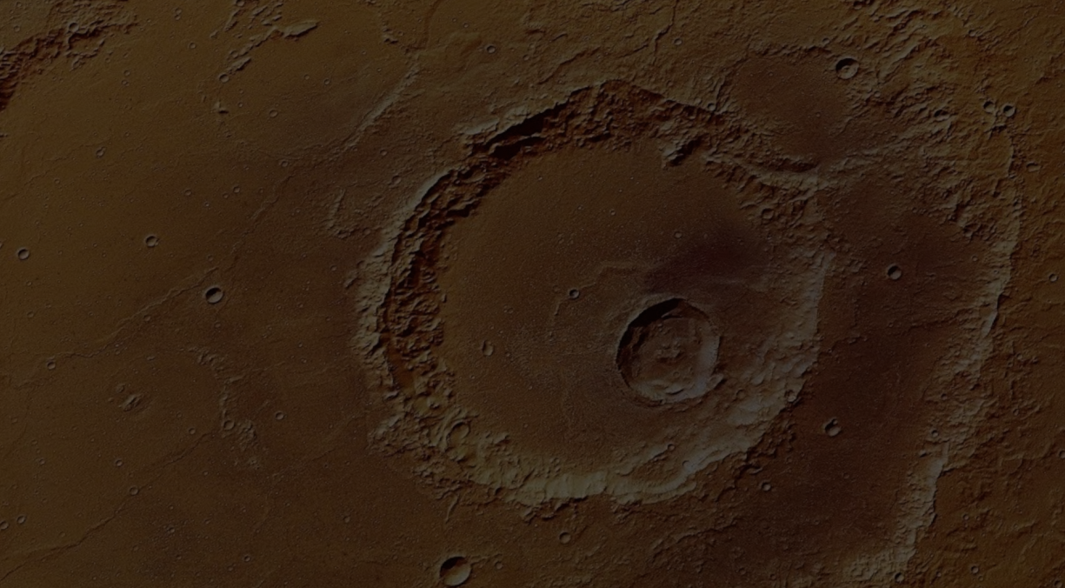

Slide 18
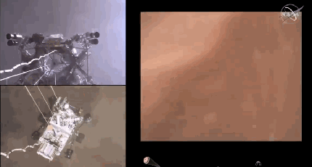

Slide 19
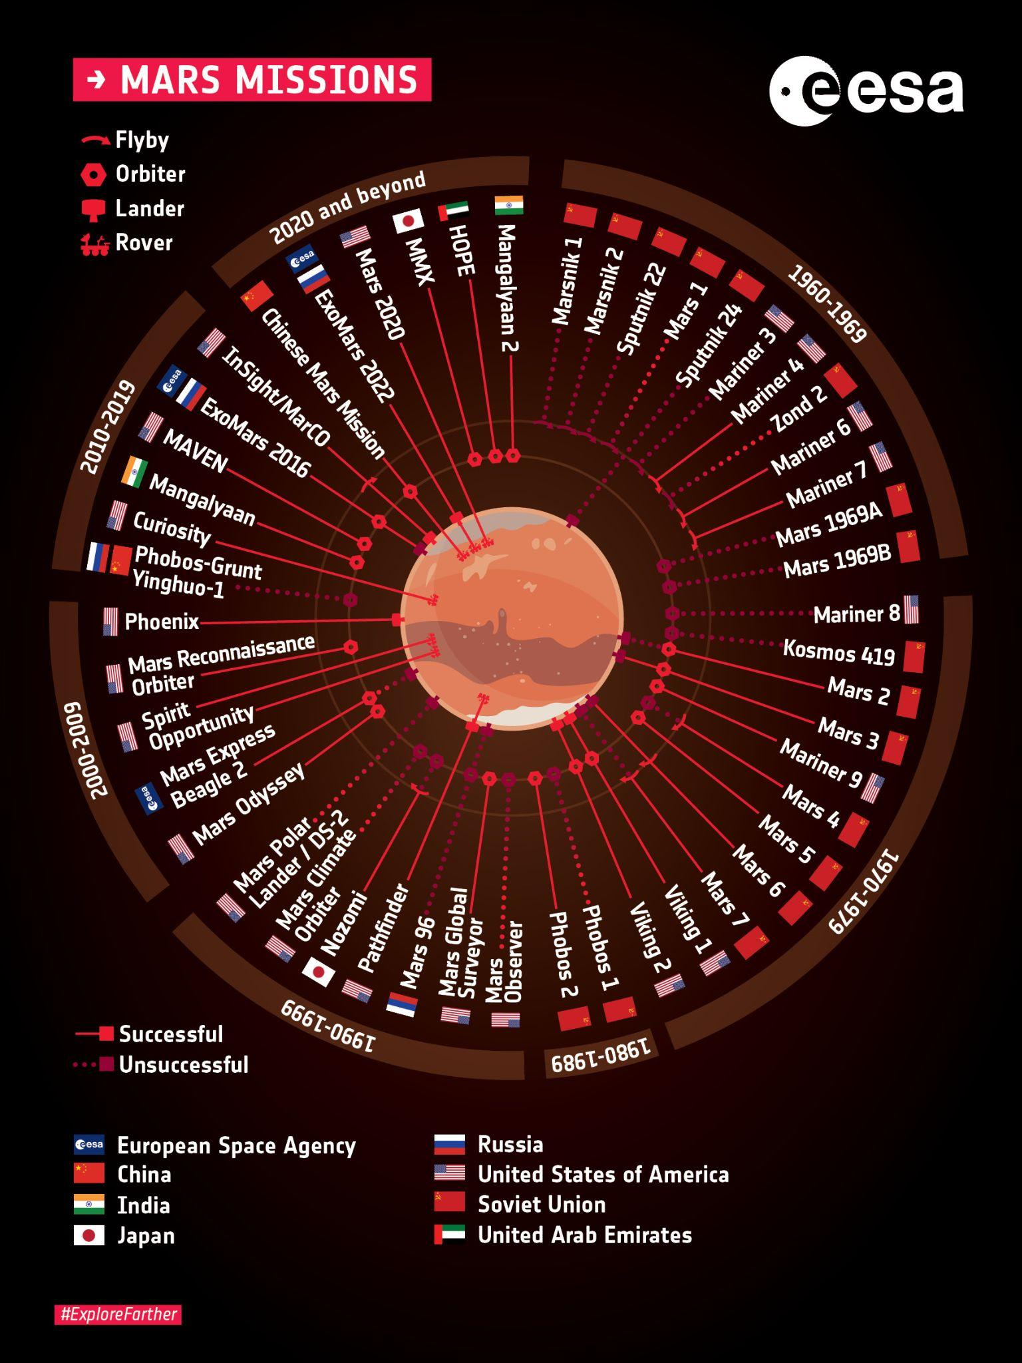
Task failed successfully.
Those who do not learn from history are destined to repeat their mistakes.
As Part of our game everytime the player fails , we will give them a short text about real life missions which failed under similar circumstances and how the respective agencies learnt from them to better their subsequent missions.

Slide 20
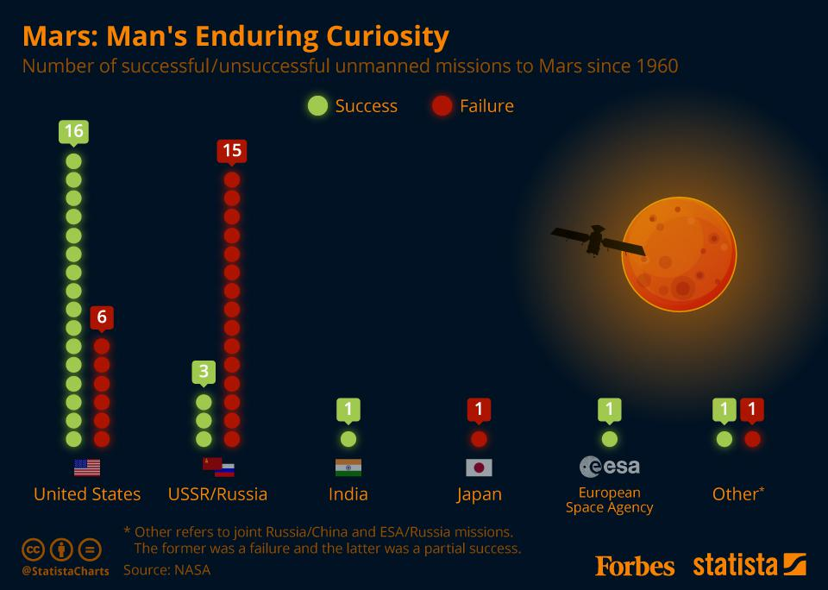

Slide 21

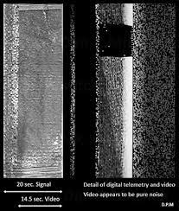
Expanded and Enhanced
-> Historical missions simulations, to illustrate how advances in technology have changed martian landings.
-> Introducing RnG elements to simulate
Certain fail states like Radio failure ,fuel leaks and module disintegration during descent to name a few.
->implement new game mechanics to illustrate the degree of minor corrections undertaken by the onboard systems to ensure successful landing.

